Slide 1

Linear Algebra For Machine Learning Deep Learning Data Science
FAHAD HUSSAIN
MCS, MSCS, DAE(CIT)
Computer Science Lecturer of well known University Pakistan,
also, Machine Learning and Deep learning Researcher.
For further assistance, code and slide https://fahadhussaincs.blogspot.com/
YouTube Channel: https://www.youtube.com/c/FahadHussaintutorial/playlists

Slide 2
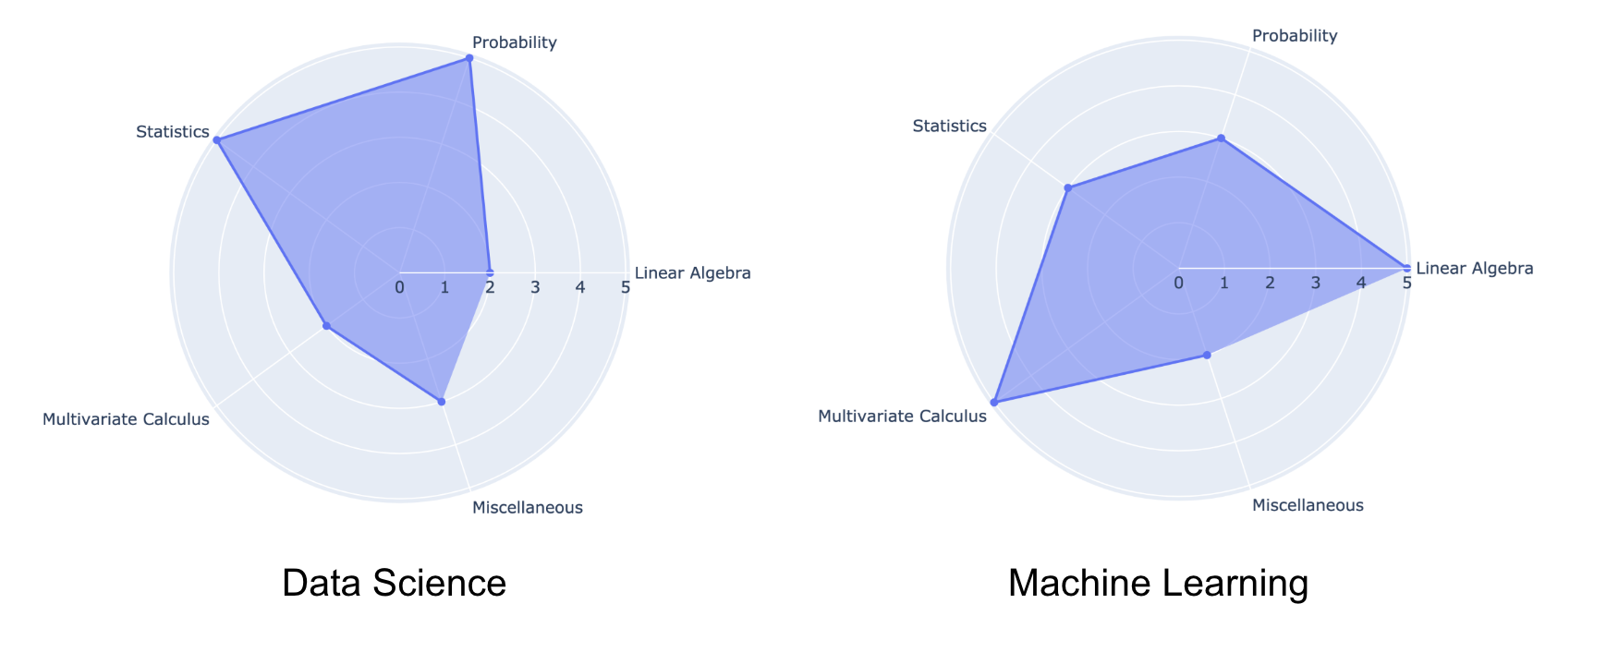
For further assistance, code and slide https://fahadhussaincs.blogspot.com/
YouTube Channel: https://www.youtube.com/c/FahadHussaintutorial/playlists

Slide 3
What we will Learn!
Vector VS Point
Vector and its Operations
Vector/Point distance
Norm I and Norm II
Unit Vector
Dot product VS Cross Product
Angle between two vector
Vector Projection
Line VS Place Vs Hyperplane
If the line passing through origin
Matrix
Matrix Types
Matrix Operations
Eign Value and Eign Vector
Factorization/Decomposition
Eign Decomposition
SVD
PCA
LDA
More Purely algebra related ML/DL/DS equations and its solutions…
For further assistance, code and slide https://fahadhussaincs.blogspot.com/
YouTube Channel: https://www.youtube.com/c/FahadHussaintutorial/playlists

Slide 4
Algebra
Algebra is one of the broad areas of mathematics. In its most general form, algebra is the study of mathematical symbols and the rules for manipulating these symbols; it is a unifying thread of almost all of mathematics.
x | + | 5 | = | 12
For further assistance, code and slide https://fahadhussaincs.blogspot.com/
YouTube Channel: https://www.youtube.com/c/FahadHussaintutorial/playlists

Slide 5
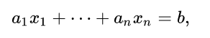
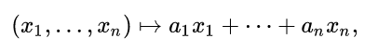
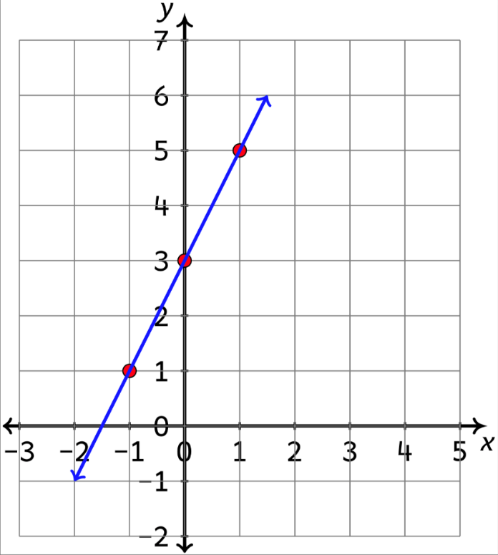
Linear Algebra
Linear algebra is the branch of mathematics concerning linear equations such as:
linear maps such as:
and their representations in vector spaces and through matrices.
OR
Study of Systems of linear equation.
OR
Linear algebra is a sub-field of mathematics concerned with vectors, matrices, and linear transforms.
For further assistance, code and slide https://fahadhussaincs.blogspot.com/
YouTube Channel: https://www.youtube.com/c/FahadHussaintutorial/playlists

Slide 6
Thanks
Do, Share and Subscribe
For further assistance, code and slide https://fahadhussaincs.blogspot.com/
YouTube Channel: https://www.youtube.com/c/FahadHussaintutorial/playlists

Slide 7
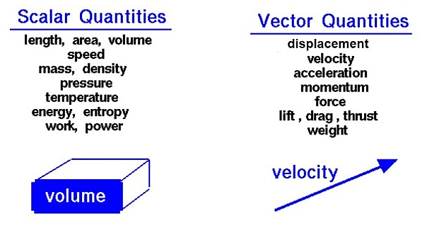
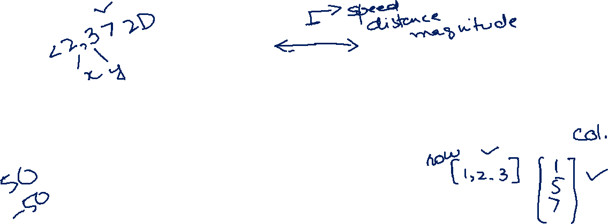
Vector VS Scalar
A quantity that has magnitude but no particular direction is described as scalar. A quantity that has magnitude and acts in a particular direction is described as vector.
V <2,3>
V <1,2>
For further assistance, code and slide https://fahadhussaincs.blogspot.com/
YouTube Channel: https://www.youtube.com/c/FahadHussaintutorial/playlists

Slide 8
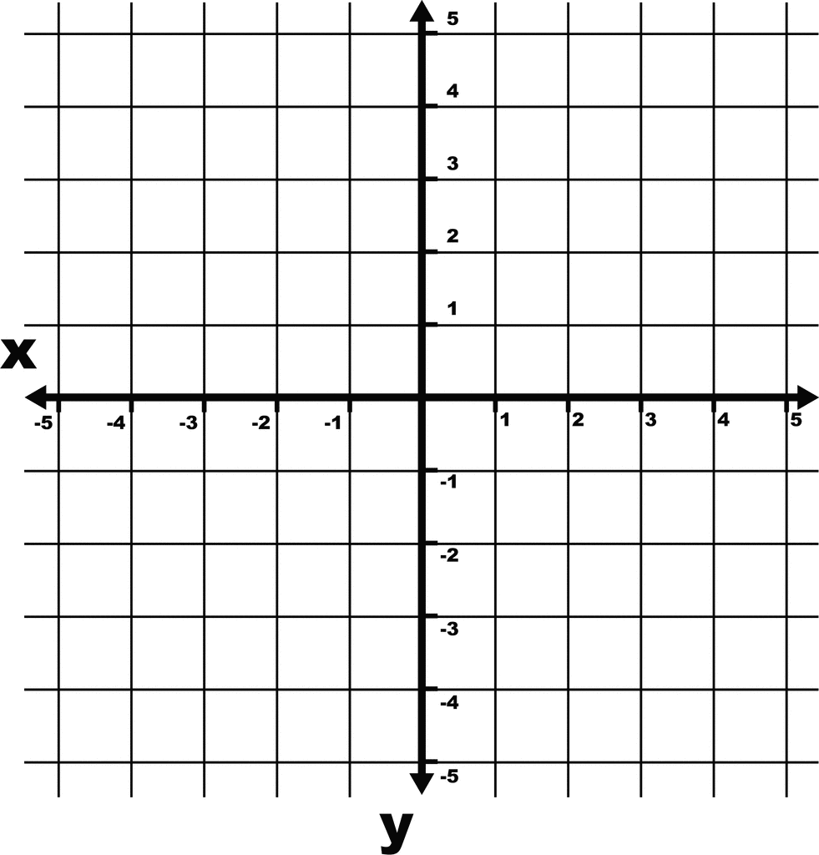
Vector vs Point
A Point has position in space. The only characteristic that distinguishes one point from another is its position. A Vector has both magnitude and direction, but no fixed position in space. Geometrically, we draw points as dots and vectors as line segments with arrows.
P (2,3)
V <1,2>
For further assistance, code and slide https://fahadhussaincs.blogspot.com/
YouTube Channel: https://www.youtube.com/c/FahadHussaintutorial/playlists

Slide 9
Vector vs Point Application
Support Vector Machine
Neural Network
NLP Vectorization etc.…
For further assistance, code and slide https://fahadhussaincs.blogspot.com/
YouTube Channel: https://www.youtube.com/c/FahadHussaintutorial/playlists

Slide 10
Thanks
Do, Share and Subscribe
For further assistance, code and slide https://fahadhussaincs.blogspot.com/
YouTube Channel: https://www.youtube.com/c/FahadHussaintutorial/playlists

Slide 11
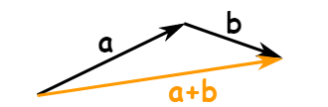
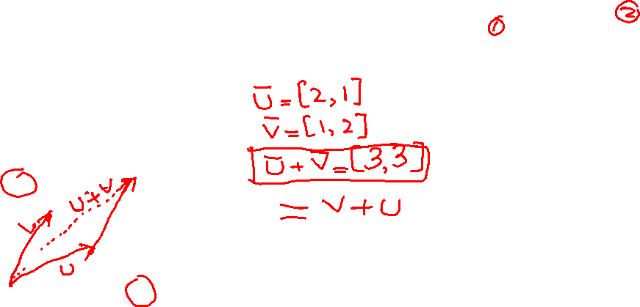
Vector Operations
Addition
Subtraction
Scalar Multiplication
For further assistance, code and slide https://fahadhussaincs.blogspot.com/
YouTube Channel: https://www.youtube.com/c/FahadHussaintutorial/playlists

Slide 12
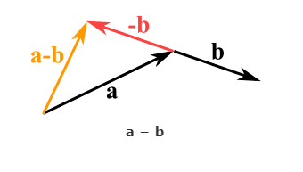
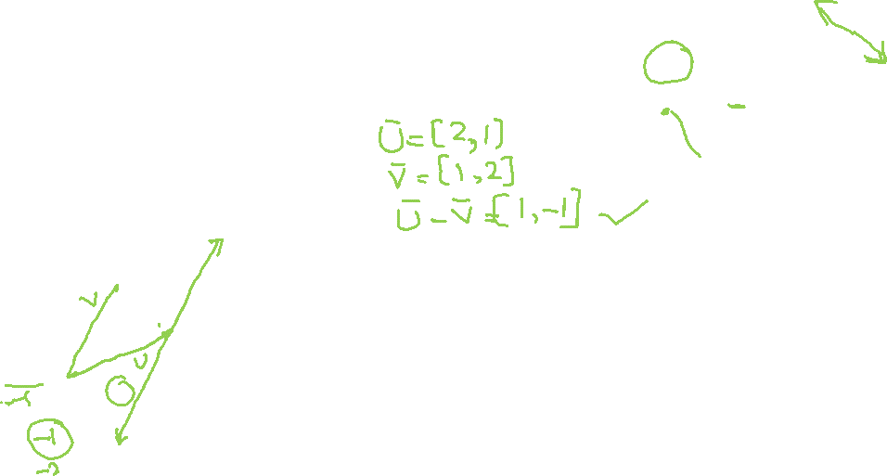
Vector Operations
Addition
Subtraction
Scalar Multiplication
For further assistance, code and slide https://fahadhussaincs.blogspot.com/
YouTube Channel: https://www.youtube.com/c/FahadHussaintutorial/playlists

Slide 13
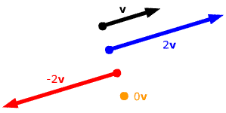
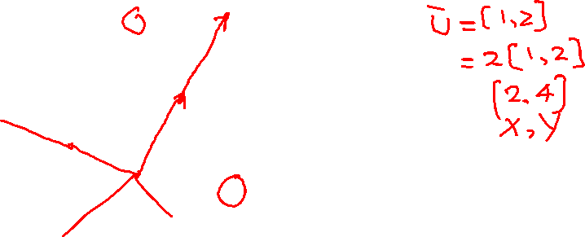
Vector Operations
Addition
Subtraction
Scalar Multiplication
For further assistance, code and slide https://fahadhussaincs.blogspot.com/
YouTube Channel: https://www.youtube.com/c/FahadHussaintutorial/playlists

Slide 14
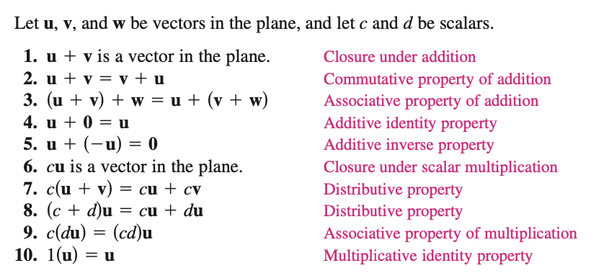
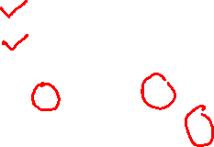
Vector Operations Rules
For further assistance, code and slide https://fahadhussaincs.blogspot.com/
YouTube Channel: https://www.youtube.com/c/FahadHussaintutorial/playlists

Slide 15
Thanks
Do, Share and Subscribe
For further assistance, code and slide https://fahadhussaincs.blogspot.com/
YouTube Channel: https://www.youtube.com/c/FahadHussaintutorial/playlists

Slide 16
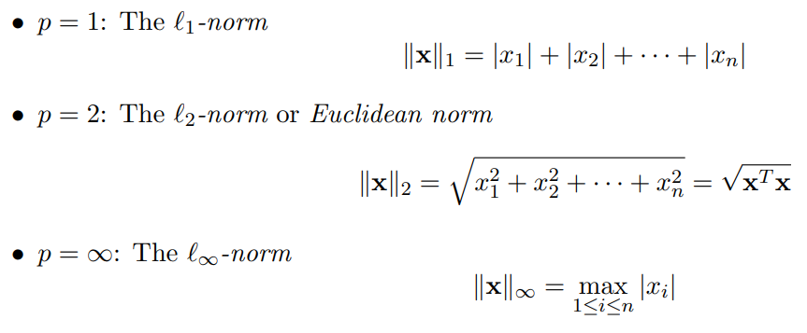
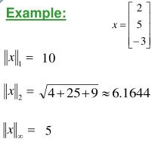
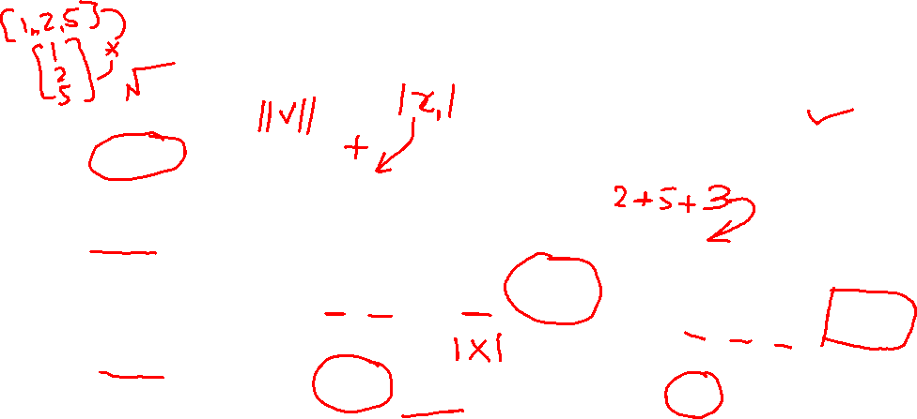
Vector Norms
For further assistance, code and slide https://fahadhussaincs.blogspot.com/
YouTube Channel: https://www.youtube.com/c/FahadHussaintutorial/playlists

Slide 17
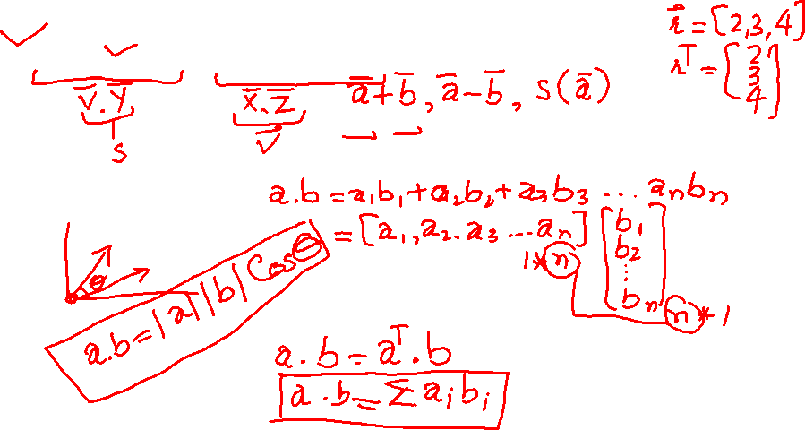
Vector Operations
Vector to Vector Multiplication
Dot Product VS Cross Product
a · b
For further assistance, code and slide https://fahadhussaincs.blogspot.com/
YouTube Channel: https://www.youtube.com/c/FahadHussaintutorial/playlists

Slide 18
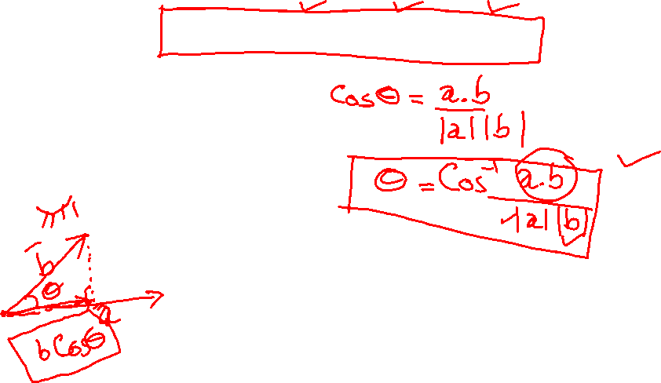
Vector Operations
a · b = ||a|| × ||b|| × cos(θ)
For further assistance, code and slide https://fahadhussaincs.blogspot.com/
YouTube Channel: https://www.youtube.com/c/FahadHussaintutorial/playlists

Slide 19
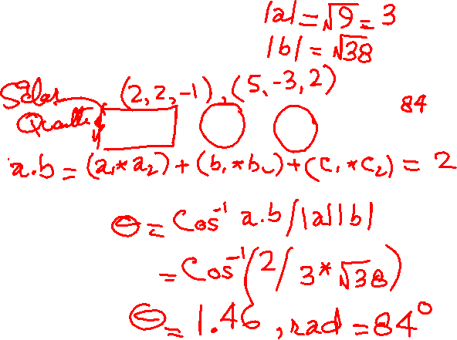
Vector Operations
Vector to Vector Multiplication
Dot Product VS Cross Product
a · b = |a| × |b| × cos(θ)
For further assistance, code and slide https://fahadhussaincs.blogspot.com/
YouTube Channel: https://www.youtube.com/c/FahadHussaintutorial/playlists

Slide 20

Vector Operations
Vector to Vector Multiplication
Dot Product VS Cross Product
a × b = |a| |b| sin(θ) n
For further assistance, code and slide https://fahadhussaincs.blogspot.com/
YouTube Channel: https://www.youtube.com/c/FahadHussaintutorial/playlists

Slide 21
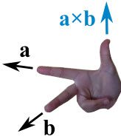

Vector Operations
Vector to Vector Multiplication
Dot Product VS Cross Product
The cross product could point in the completely opposite direction and still be at right angles to the two other vectors, so we have the:
"Right Hand Rule"
With your right-hand, point your index finger along vector a, and point your middle finger along vector b: the cross product goes in the direction of your thumb.
For further assistance, code and slide https://fahadhussaincs.blogspot.com/
YouTube Channel: https://www.youtube.com/c/FahadHussaintutorial/playlists

Slide 22
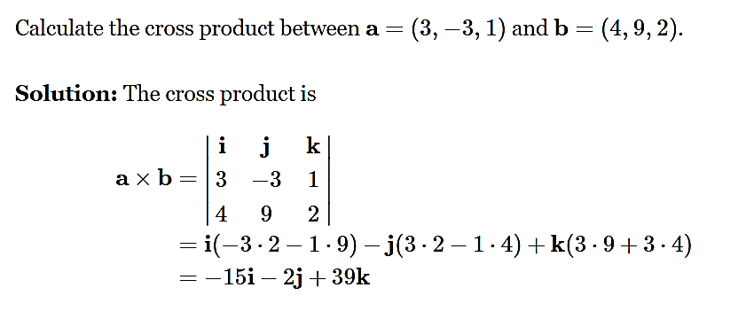

Vector Operations
Vector to Vector Multiplication
Dot Product VS Cross Product
For further assistance, code and slide https://fahadhussaincs.blogspot.com/
YouTube Channel: https://www.youtube.com/c/FahadHussaintutorial/playlists

Slide 23
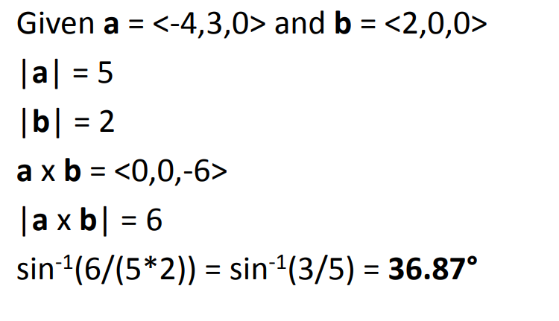
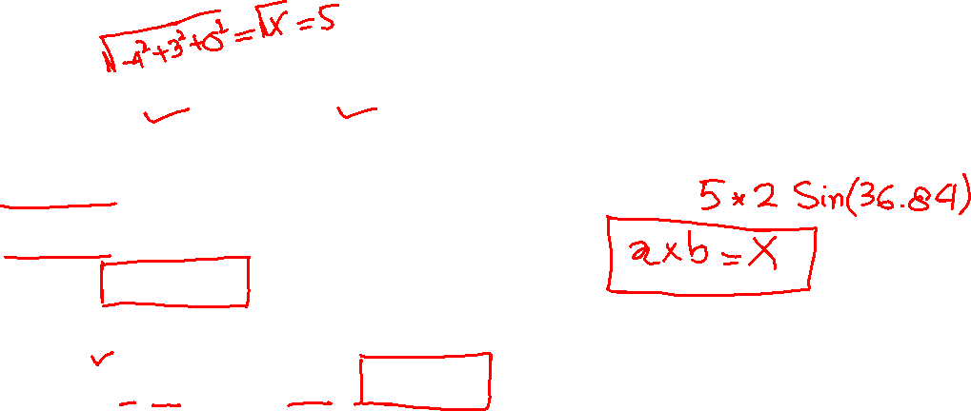
Vector Operations
Vector to Vector Multiplication
Dot Product VS Cross Product
a × b = |a| |b| sin(θ) n
For further assistance, code and slide https://fahadhussaincs.blogspot.com/
YouTube Channel: https://www.youtube.com/c/FahadHussaintutorial/playlists

Slide 24
Unit Vector
A unit vector in a given direction is a vector with magnitude ONE in that direct.
Used to represent that direction of a vector.
https://www.youtube.com/watch?v=jCkhbKFZgLk
https://www.youtube.com/watch?v=pDq-HG9NN8E
For further assistance, code and slide https://fahadhussaincs.blogspot.com/
YouTube Channel: https://www.youtube.com/c/FahadHussaintutorial/playlists

Slide 25
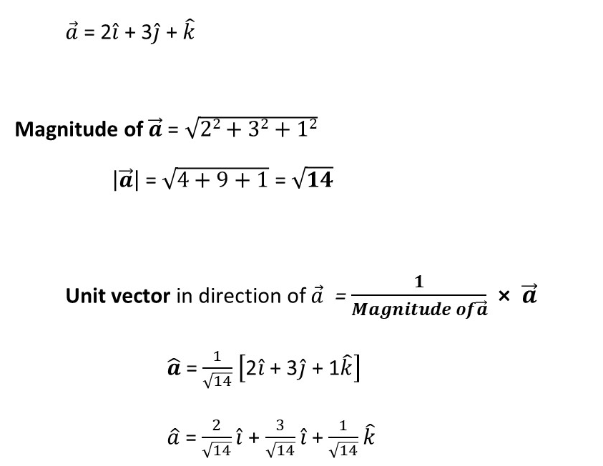
Unit Vector
For further assistance, code and slide https://fahadhussaincs.blogspot.com/
YouTube Channel: https://www.youtube.com/c/FahadHussaintutorial/playlists

Slide 26
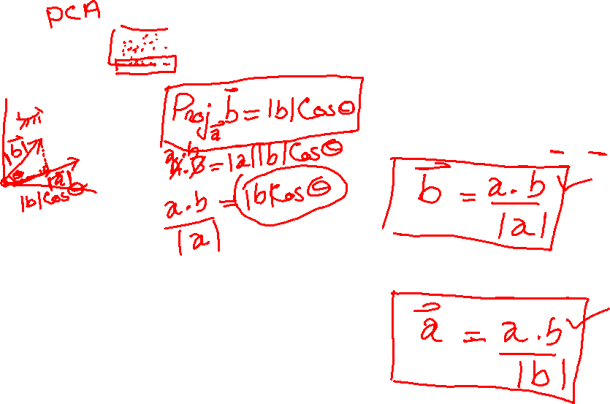
Vector Projection
Projection of vector b on a
Projection of vector a on b
For further assistance, code and slide https://fahadhussaincs.blogspot.com/
YouTube Channel: https://www.youtube.com/c/FahadHussaintutorial/playlists

Slide 27
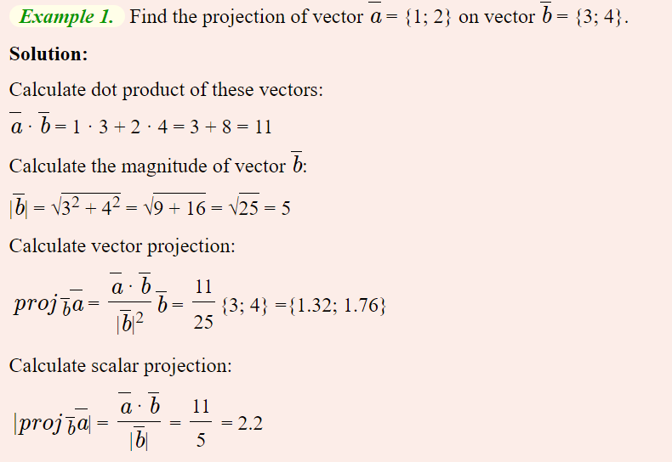
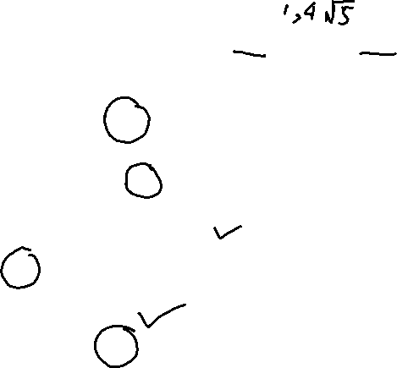
Vector Projection
For further assistance, code and slide https://fahadhussaincs.blogspot.com/
YouTube Channel: https://www.youtube.com/c/FahadHussaintutorial/playlists

Slide 28
Thanks
Do, Share and Subscribe
For further assistance, code and slide https://fahadhussaincs.blogspot.com/
YouTube Channel: https://www.youtube.com/c/FahadHussaintutorial/playlists

Slide 29
Vector and its Types
Parallel Vector
Perpendicular (Orthogonal) Vector
Orthonormal Vector
Like Unlike Vector
Equal Vector
Colinear Vector
Unit Vector
Position Vector
Zero Vector
Free Vector
Negative Vector
For further assistance, code and slide https://fahadhussaincs.blogspot.com/
YouTube Channel: https://www.youtube.com/c/FahadHussaintutorial/playlists

Slide 30
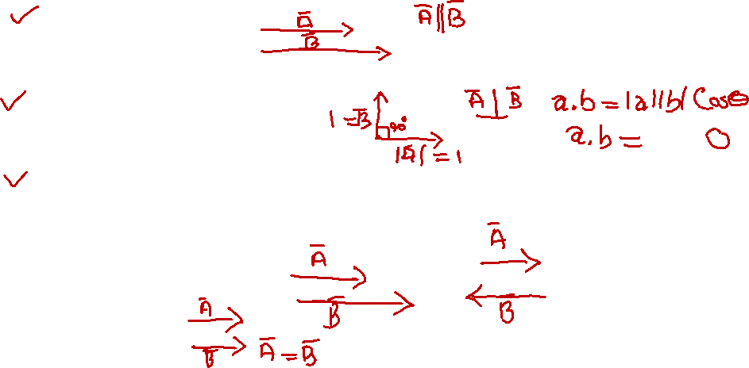
Vector and its Types
Parallel Vector
Perpendicular (Orthogonal) Vector
Orthonormal Vector
Like and Unlike Vector
Equal Vector
For further assistance, code and slide https://fahadhussaincs.blogspot.com/
YouTube Channel: https://www.youtube.com/c/FahadHussaintutorial/playlists

Slide 31
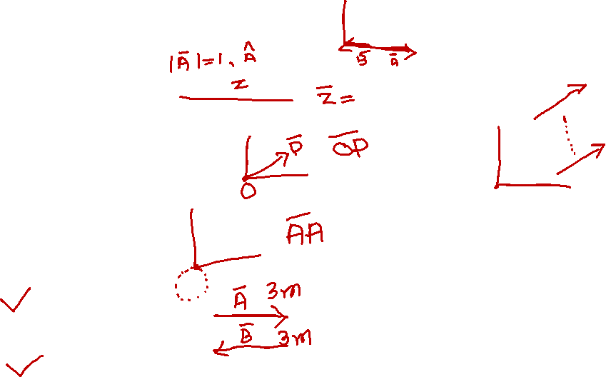
Vector and its Types
Colinear Vector
Unit Vector
Position Vector
Zero Vector
Free Vector
Negative Vector
For further assistance, code and slide https://fahadhussaincs.blogspot.com/
YouTube Channel: https://www.youtube.com/c/FahadHussaintutorial/playlists

Slide 32
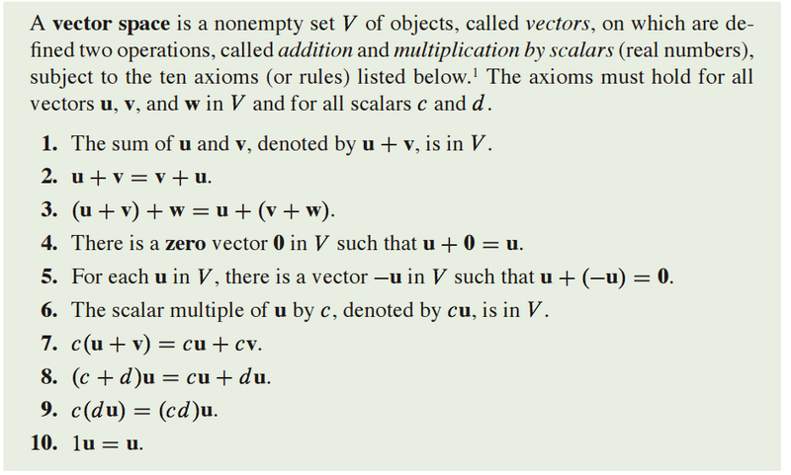
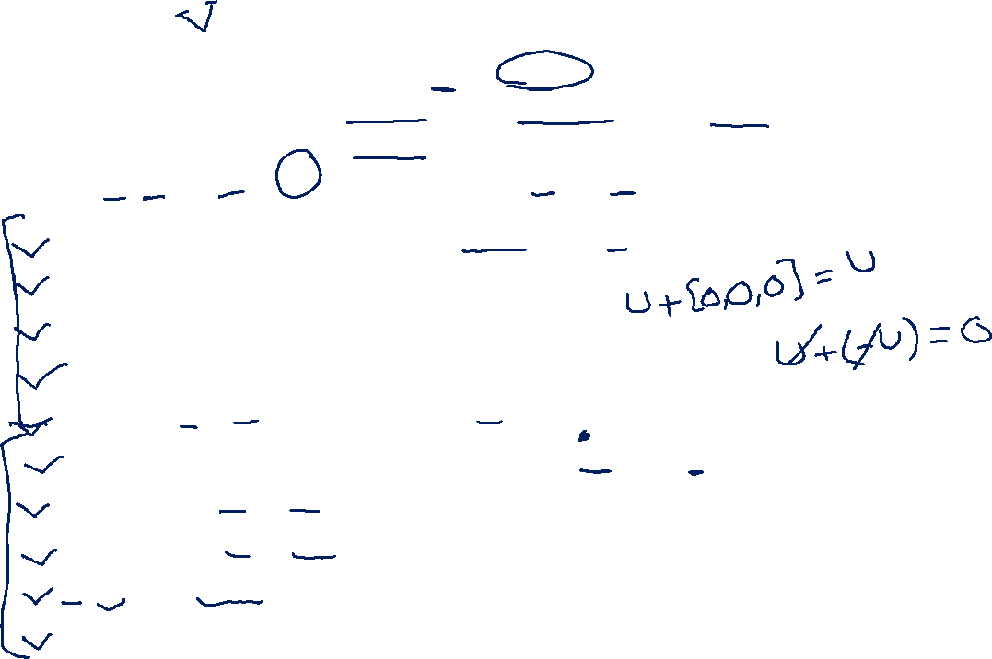
Vector Space
For further assistance, code and slide https://fahadhussaincs.blogspot.com/
YouTube Channel: https://www.youtube.com/c/FahadHussaintutorial/playlists

Slide 33
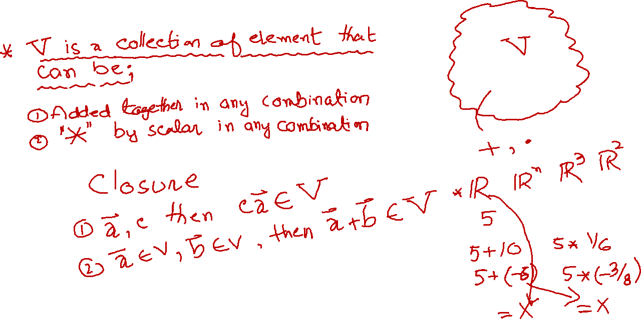
Vector Space
For further assistance, code and slide https://fahadhussaincs.blogspot.com/
YouTube Channel: https://www.youtube.com/c/FahadHussaintutorial/playlists

Slide 34
Vector Space Example
The set of all real number R associated with the addition and scalar multiplication of real numbers.
The set of all the complex numbers C associated with the addition and scalar multiplication of complex numbers.
The set of all polynomials Rn(x) with real coefficients associated with the addition and scalar multiplication of polynomials.
For further assistance, code and slide https://fahadhussaincs.blogspot.com/
YouTube Channel: https://www.youtube.com/c/FahadHussaintutorial/playlists

Slide 35
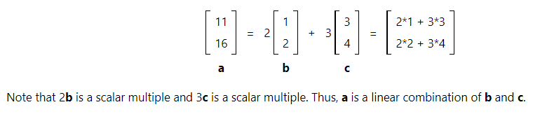

Linear Combination of Vectors
If one vector is equal to the sum of scalar multiples of other vectors, it is said to be a linear combination of the other vectors.
For further assistance, code and slide https://fahadhussaincs.blogspot.com/
YouTube Channel: https://www.youtube.com/c/FahadHussaintutorial/playlists

Slide 36
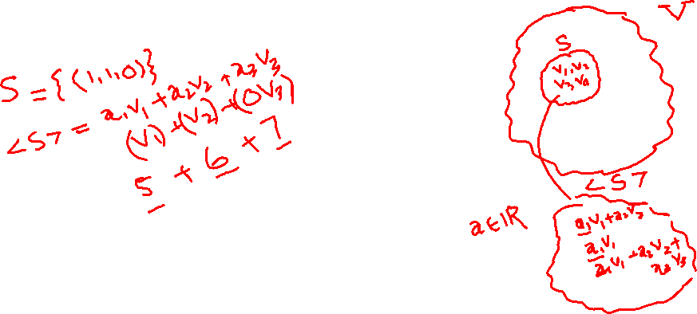
Spanning Set
Let S be a non-empty subset of vector Space V. The set of all linear combination of elements of S is called linear span of S and is donated by <S>.
For further assistance, code and slide https://fahadhussaincs.blogspot.com/
YouTube Channel: https://www.youtube.com/c/FahadHussaintutorial/playlists

Slide 37

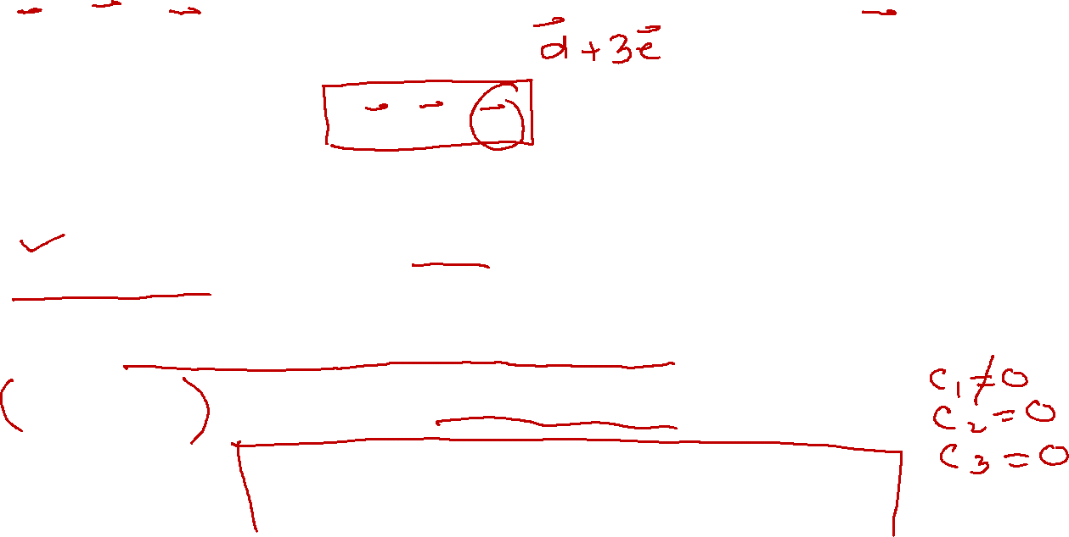
Linearly independent and Linearly dependent
a b c c = a + 2b
2a + b – c
2a + b – (a + 2b)
Here c is written in the terms of a and b means its unnecessary information that why its called linearly dependent.
And if none of vector can be written in term of others, called linearly independent.
V1, V2, V3 … Vn in Vector space V, for linearly independence must be satisfy:
C1V1 + C2V2 + C3V3 ….. CnVn = 0
For further assistance, code and slide https://fahadhussaincs.blogspot.com/
YouTube Channel: https://www.youtube.com/c/FahadHussaintutorial/playlists

Slide 38
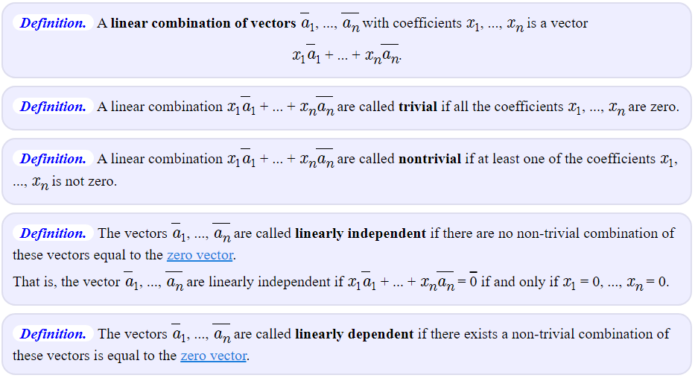

Linearly independent and Linearly dependent
http://www.math.odu.edu/~bogacki/cgi-bin/lat.cgi
For further assistance, code and slide https://fahadhussaincs.blogspot.com/
YouTube Channel: https://www.youtube.com/c/FahadHussaintutorial/playlists

Slide 39
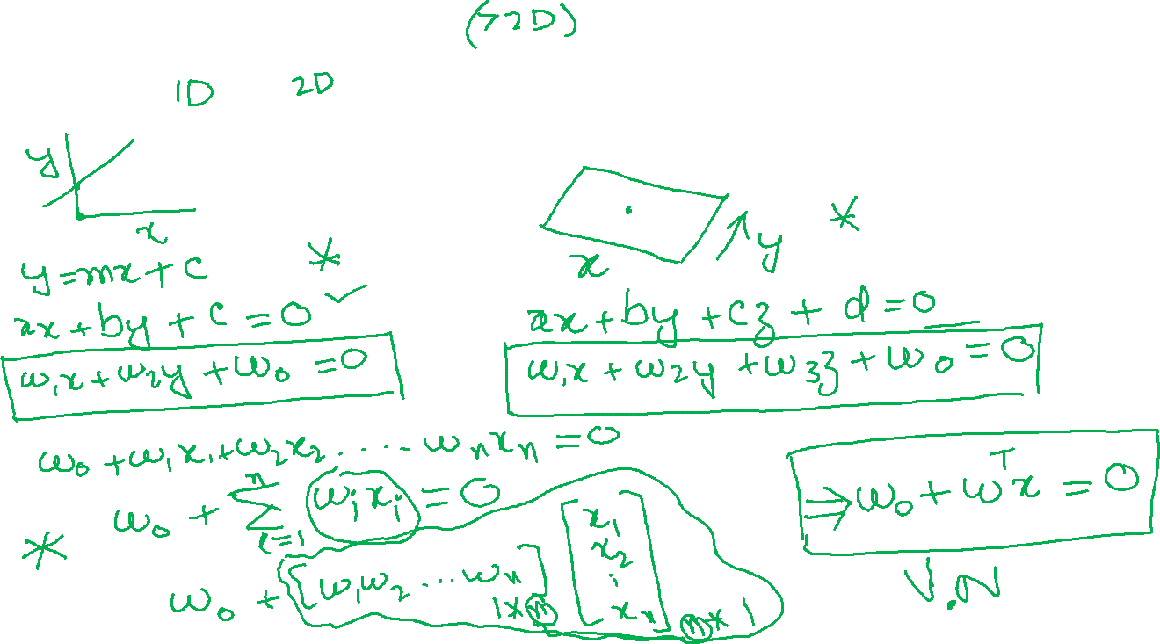
Lines, Plane, Hyperplane, Point, Segment, Linear, Collinear, Copular
For further assistance, code and slide https://fahadhussaincs.blogspot.com/
YouTube Channel: https://www.youtube.com/c/FahadHussaintutorial/playlists

Slide 40
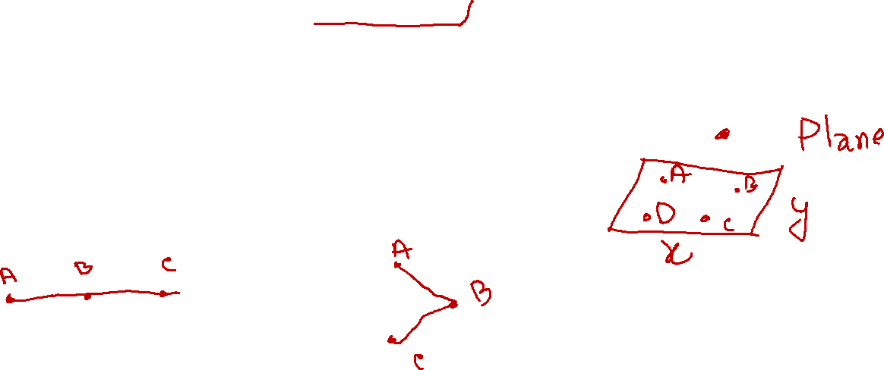
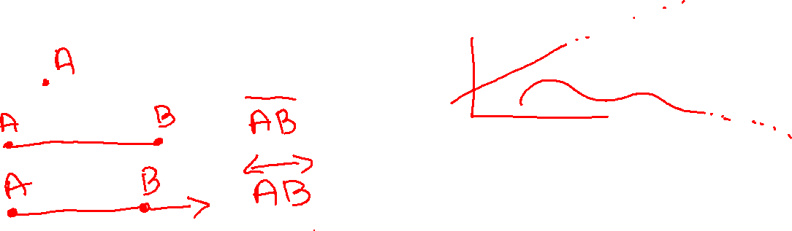
Lines, Plane, Hyperplane, Point, Segment, Linear, Collinear, Copular
For further assistance, code and slide https://fahadhussaincs.blogspot.com/
YouTube Channel: https://www.youtube.com/c/FahadHussaintutorial/playlists

Slide 41
Thanks
Do, Share and Subscribe
For further assistance, code and slide https://fahadhussaincs.blogspot.com/
YouTube Channel: https://www.youtube.com/c/FahadHussaintutorial/playlists

Slide 42
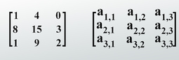
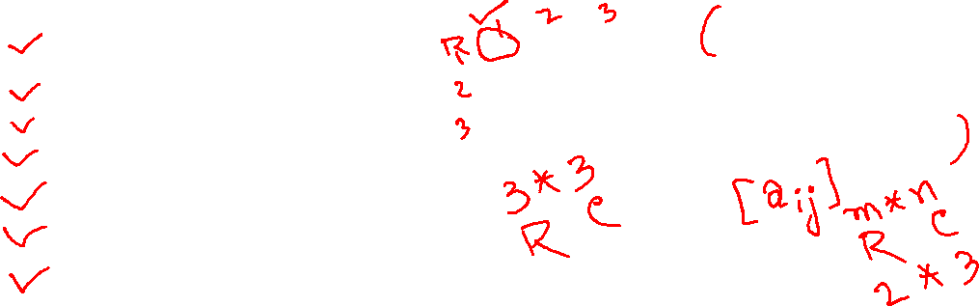
Matrix Types
A matrix (plural matrices) is a rectangular array or table of numbers, symbols, or expressions, arranged in rows and columns, which is used to represent a mathematical object or a property of such an object.
Square Matrix
Symmetric Matrix
Triangular Matrix
Diagonal Matrix
Identity Matrix
Orthogonal Matrix
Sparse Matrix
For further assistance, code and slide https://fahadhussaincs.blogspot.com/
YouTube Channel: https://www.youtube.com/c/FahadHussaintutorial/playlists

Slide 43
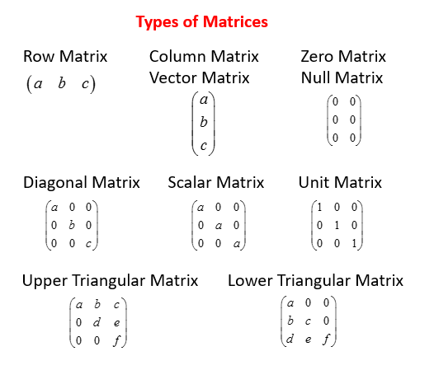

For further assistance, code and slide https://fahadhussaincs.blogspot.com/
YouTube Channel: https://www.youtube.com/c/FahadHussaintutorial/playlists

Slide 44
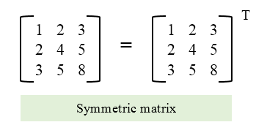
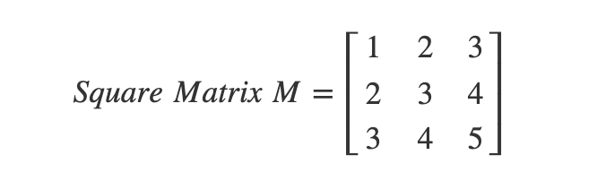
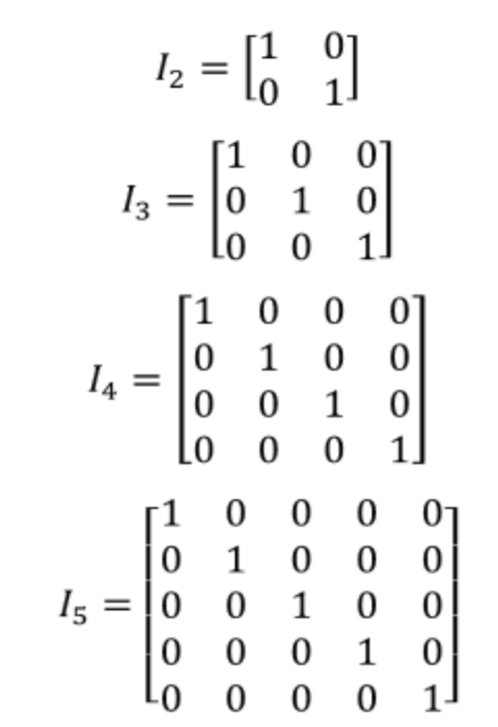
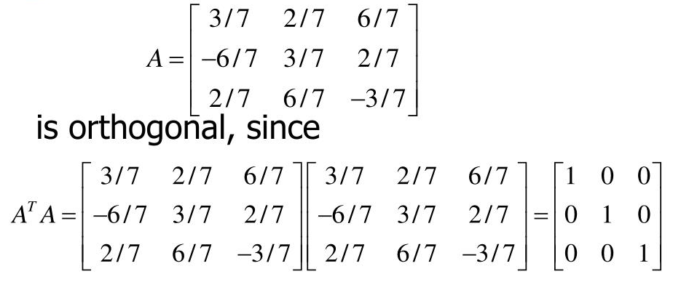
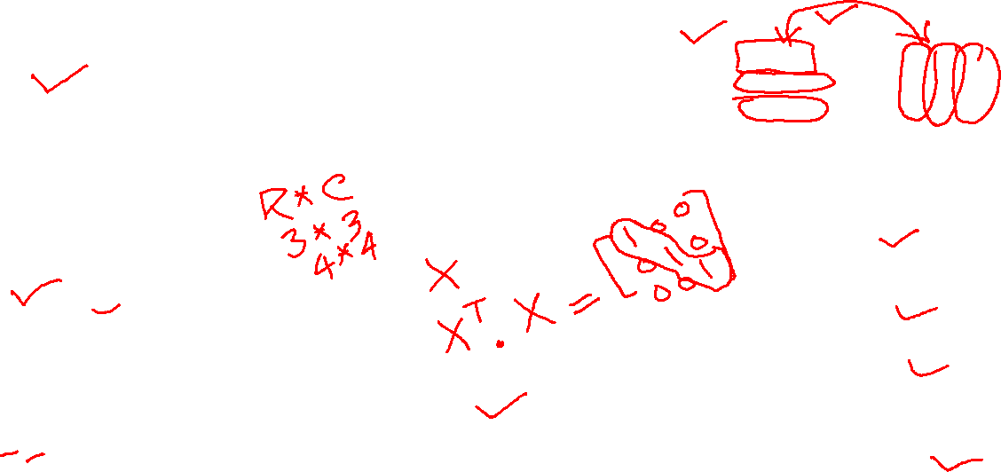
For further assistance, code and slide https://fahadhussaincs.blogspot.com/
YouTube Channel: https://www.youtube.com/c/FahadHussaintutorial/playlists

Slide 45
Thanks
Do, Share and Subscribe
For further assistance, code and slide https://fahadhussaincs.blogspot.com/
YouTube Channel: https://www.youtube.com/c/FahadHussaintutorial/playlists

Slide 46
Matrix Operations
Transpose
Sum
Difference
Scalar multiplication
Matrix multiplication (Dot Product Or Inner Product)
Matrix-Vector Product
For further assistance, code and slide https://fahadhussaincs.blogspot.com/
YouTube Channel: https://www.youtube.com/c/FahadHussaintutorial/playlists

Slide 47
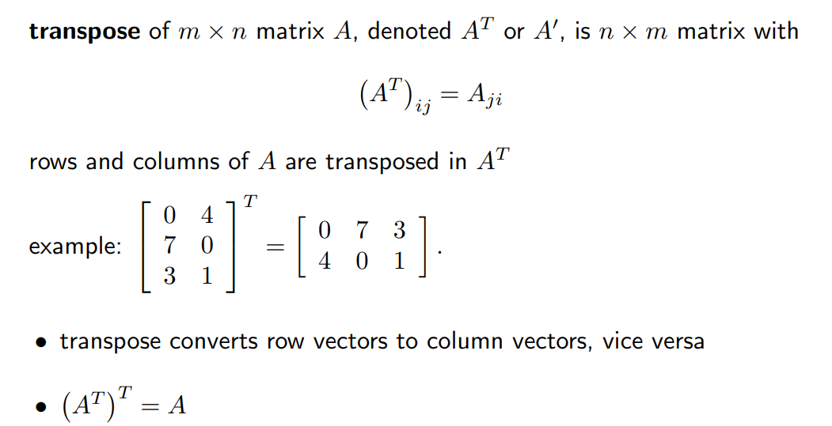
Matrix Operations
For further assistance, code and slide https://fahadhussaincs.blogspot.com/
YouTube Channel: https://www.youtube.com/c/FahadHussaintutorial/playlists

Slide 48

For further assistance, code and slide https://fahadhussaincs.blogspot.com/
YouTube Channel: https://www.youtube.com/c/FahadHussaintutorial/playlists

Slide 49

For further assistance, code and slide https://fahadhussaincs.blogspot.com/
YouTube Channel: https://www.youtube.com/c/FahadHussaintutorial/playlists

Slide 50

For further assistance, code and slide https://fahadhussaincs.blogspot.com/
YouTube Channel: https://www.youtube.com/c/FahadHussaintutorial/playlists

Slide 51

For further assistance, code and slide https://fahadhussaincs.blogspot.com/
YouTube Channel: https://www.youtube.com/c/FahadHussaintutorial/playlists

Slide 52

For further assistance, code and slide https://fahadhussaincs.blogspot.com/
YouTube Channel: https://www.youtube.com/c/FahadHussaintutorial/playlists

Slide 53

For further assistance, code and slide https://fahadhussaincs.blogspot.com/
YouTube Channel: https://www.youtube.com/c/FahadHussaintutorial/playlists

Slide 54

Matrix Multiplication
Inner product or Dot Product of Matrix
https://matrixcalc.org/en/#%7B%7B1,2%7D,%7B1,1%7D%7D-%7B%7B1,4%7D,%7B2,1%7D%7D
For further assistance, code and slide https://fahadhussaincs.blogspot.com/
YouTube Channel: https://www.youtube.com/c/FahadHussaintutorial/playlists

Slide 55
Matrix Multiplication
Hadamard product Matrix
Hadamard product of two vectors is very similar to matrix addition, elements corresponding to same row and columns of given vectors/matrices are multiplied together to form a new vector/matrix.
For further assistance, code and slide https://fahadhussaincs.blogspot.com/
YouTube Channel: https://www.youtube.com/c/FahadHussaintutorial/playlists

Slide 56
Matrix Multiplication
Cross Product Matrix
For further assistance, code and slide https://fahadhussaincs.blogspot.com/
YouTube Channel: https://www.youtube.com/c/FahadHussaintutorial/playlists

Slide 57
Matrix Operations
Matrix Power
Matrix Determinant
Matrix Inverse
Matrix Rank
For further assistance, code and slide https://fahadhussaincs.blogspot.com/
YouTube Channel: https://www.youtube.com/c/FahadHussaintutorial/playlists

Slide 58

For further assistance, code and slide https://fahadhussaincs.blogspot.com/
YouTube Channel: https://www.youtube.com/c/FahadHussaintutorial/playlists

Slide 59

For further assistance, code and slide https://fahadhussaincs.blogspot.com/
YouTube Channel: https://www.youtube.com/c/FahadHussaintutorial/playlists

Slide 60

The determinant of a matrix is a special value that is calculated from a square matrix. It can help you determine whether a matrix has an inverse, find the area of a triangle, and let you know if the system of equations has a unique solution.
The determinant is useful for solving linear equations, capturing how linear transformation change area or volume, and changing variables in integrals.
The determinant can be viewed as a function whose input is a square matrix and whose output is a number
For further assistance, code and slide https://fahadhussaincs.blogspot.com/
YouTube Channel: https://www.youtube.com/c/FahadHussaintutorial/playlists

Slide 61

For further assistance, code and slide https://fahadhussaincs.blogspot.com/
YouTube Channel: https://www.youtube.com/c/FahadHussaintutorial/playlists

Slide 62

For further assistance, code and slide https://fahadhussaincs.blogspot.com/
YouTube Channel: https://www.youtube.com/c/FahadHussaintutorial/playlists

Slide 63



For further assistance, code and slide https://fahadhussaincs.blogspot.com/
YouTube Channel: https://www.youtube.com/c/FahadHussaintutorial/playlists

Slide 64

For further assistance, code and slide https://fahadhussaincs.blogspot.com/
YouTube Channel: https://www.youtube.com/c/FahadHussaintutorial/playlists

Slide 65

Why Do We Need an Inverse?
Because with matrices we don't divide! Seriously, there is no concept of dividing by a matrix.
But we can multiply by an inverse, which achieves the same thing.
For further assistance, code and slide https://fahadhussaincs.blogspot.com/
YouTube Channel: https://www.youtube.com/c/FahadHussaintutorial/playlists

Slide 66

For further assistance, code and slide https://fahadhussaincs.blogspot.com/
YouTube Channel: https://www.youtube.com/c/FahadHussaintutorial/playlists

Slide 67

Matrix Rank
The rank is how many of the rows are "unique": not made of other rows. (Same for columns.)
The rank tells us a lot about the matrix.
It is useful in letting us know if we have a chance of solving a system of linear equations: when the rank equals the number of variables we may be able to find a unique solution.
For further assistance, code and slide https://fahadhussaincs.blogspot.com/
YouTube Channel: https://www.youtube.com/c/FahadHussaintutorial/playlists

Slide 68
Linear Equation and System of Linear Equation
An equation in which variable's highest power is 1.
x + 4 = 0
x + 9 = 3
In general form:
a x + a x + ..... a x = c
For further assistance, code and slide https://fahadhussaincs.blogspot.com/
YouTube Channel: https://www.youtube.com/c/FahadHussaintutorial/playlists

Slide 69



System of Linear Equation
A system(group) of two or more linear equations involving same variables is called system of linear equations(Linear Equation).
For further assistance, code and slide https://fahadhussaincs.blogspot.com/
YouTube Channel: https://www.youtube.com/c/FahadHussaintutorial/playlists

Slide 70
System of Linear Equation
For further assistance, code and slide https://fahadhussaincs.blogspot.com/
YouTube Channel: https://www.youtube.com/c/FahadHussaintutorial/playlists

Slide 71

System of Linear Equation
While solving System of linear equation one of three possible solution possible.
For further assistance, code and slide https://fahadhussaincs.blogspot.com/
YouTube Channel: https://www.youtube.com/c/FahadHussaintutorial/playlists

Slide 72
System of Linear Equation
3x + 2y = 19
x + y = 8
For further assistance, code and slide https://fahadhussaincs.blogspot.com/
YouTube Channel: https://www.youtube.com/c/FahadHussaintutorial/playlists

Slide 73

Eigenvector and Eigenvalue
For further assistance, code and slide https://fahadhussaincs.blogspot.com/
YouTube Channel: https://www.youtube.com/c/FahadHussaintutorial/playlists

Slide 74
Eigenvector and Eigenvalue
For further assistance, code and slide https://fahadhussaincs.blogspot.com/
YouTube Channel: https://www.youtube.com/c/FahadHussaintutorial/playlists

Slide 75


Eigenvector and Eigenvalue

Slide 76
Linear Transformation
For further assistance, code and slide https://fahadhussaincs.blogspot.com/
YouTube Channel: https://www.youtube.com/c/FahadHussaintutorial/playlists

Slide 77

Linear Transformation
A transformation is a technique in which a vector gets converted into another by keeping a unique element from each of the original vector and assigning it into the resulting vector. This process basically maps one vector space into another.
Its must follow the following condition as Linear Transformation.
For further assistance, code and slide https://fahadhussaincs.blogspot.com/
YouTube Channel: https://www.youtube.com/c/FahadHussaintutorial/playlists

Slide 78

Linear Transformation
For further assistance, code and slide https://fahadhussaincs.blogspot.com/
YouTube Channel: https://www.youtube.com/c/FahadHussaintutorial/playlists

Slide 79

Linear Transformation
For further assistance, code and slide https://fahadhussaincs.blogspot.com/
YouTube Channel: https://www.youtube.com/c/FahadHussaintutorial/playlists

Slide 80
Image and Kernel of Linear Transformation
Image
For further assistance, code and slide https://fahadhussaincs.blogspot.com/
YouTube Channel: https://www.youtube.com/c/FahadHussaintutorial/playlists

Slide 81
Image and Kernel of Linear Transformation
Image
For further assistance, code and slide https://fahadhussaincs.blogspot.com/
YouTube Channel: https://www.youtube.com/c/FahadHussaintutorial/playlists

Slide 82
Kernel
For further assistance, code and slide https://fahadhussaincs.blogspot.com/
YouTube Channel: https://www.youtube.com/c/FahadHussaintutorial/playlists

Slide 83
Matrix Norm L1, L-infinity, Frobenius norm
A matrix norm is a number defined in terms of the entries of the matrix. The norm is a useful quantity which can give important information about a matrix.
To estimate how big a vector/tensor is
To estimate how close one tensor to another

Slide 84


Matrix Norm and Frobenius norm of a matrix

Slide 85


Matrix Norm and Frobenius norm of a matrix

Slide 86


Frobenius norm of a matrix

Slide 87
Frobenius norm of a matrix
The L2 (or L^2) norm is the Euclidian norm of a vector.
The Frobenius norm is the Euclidian norm of a matrix.

Slide 88
Gram Schmidt Process
Orthonormal and Orthogonal
For further assistance, code and slide https://fahadhussaincs.blogspot.com/
YouTube Channel: https://www.youtube.com/c/FahadHussaintutorial/playlists

Slide 89
Gram Schmidt Process
Gram–Schmidt process is a method for orthonormalizing a set of vectors in an inner product space, most commonly the Euclidean space R^n equipped with the standard inner product. The Gram–Schmidt process takes a finite, linearly independent set of vectors S = {v1, ..., vk} for k ≤ n and generates an orthogonal set S′ = {u1, ..., uk} that spans the same k-dimensional subspace of R^n as S.
The Gram Schmidt process is used to transform a set of linearly independent vectors into a set of orthonormal vectors forming an orthonormal basis. It allows us to check whether vectors in a set are linearly independent.
For further assistance, code and slide https://fahadhussaincs.blogspot.com/
YouTube Channel: https://www.youtube.com/c/FahadHussaintutorial/playlists

Slide 90

Gram Schmidt Process
For further assistance, code and slide https://fahadhussaincs.blogspot.com/
YouTube Channel: https://www.youtube.com/c/FahadHussaintutorial/playlists

Slide 91

Gram Schmidt Process, Example
For further assistance, code and slide https://fahadhussaincs.blogspot.com/
YouTube Channel: https://www.youtube.com/c/FahadHussaintutorial/playlists

Slide 92
Factorization / Decomposition
For further assistance, code and slide https://fahadhussaincs.blogspot.com/
YouTube Channel: https://www.youtube.com/c/FahadHussaintutorial/playlists

Slide 93
Factorization / Decomposition
Many complex matrix operations cannot be solved efficiently or with stability using the limited precision of computers.
Matrix decompositions are methods that reduce a matrix into constituent parts that make it easier to calculate more complex matrix operations. Matrix decomposition methods, also called matrix factorization methods, are a foundation of linear algebra in computers, even for basic operations such as solving systems of linear equations, calculating the inverse, and calculating the determinant of a matrix.
For further assistance, code and slide https://fahadhussaincs.blogspot.com/
YouTube Channel: https://www.youtube.com/c/FahadHussaintutorial/playlists

Slide 94

Eigenvalue Decomposition
Eigendecomposition is the factorization of a matrix into a canonical form, whereby the matrix is represented in terms of its eigenvalues and eigenvectors. Only diagonalizable matrices can be factorized in this way. When the matrix being factorized is a normal or real symmetric matrix, the decomposition is called "spectral decomposition", derived from the spectral theorem.
1 4
1
= 7, = -5
V1 = V2=

Slide 95
Eigenvalue Decomposition
Eigendecomposition is the factorization of a matrix into a canonical form, whereby the matrix is represented in terms of its eigenvalues and eigenvectors. Only diagonalizable matrices can be factorized in this way. When the matrix being factorized is a normal or real symmetric matrix, the decomposition is called "spectral decomposition", derived from the spectral theorem.
1 4
1
= 7, = -5
V1 = V2=

Slide 96
Eigenvector and Eigenvalue

Slide 97

LU Decomposition
LU decomposition of a matrix is the factorization of a given square matrix into two triangular matrices, one upper triangular matrix and one lower triangular matrix, such that the product of these two matrices gives the original matrix. It was introduced by Alan Turing in 1948, who also created the Turing machine

Slide 98

LU Decomposition

Slide 99

LU Decomposition

Slide 100
LU Decomposition Application
This method of factorizing a matrix as a product of two triangular matrices has various applications such as a solution of a system of equations, which itself is an integral part of many applications such as finding current in a circuit and solution of discrete dynamical system problems; finding the inverse of a matrix and finding the determinant of the matrix.
Basically, the LU decomposition method comes in handy whenever it is possible to model the problem to be solved into matrix form. Conversion to the matrix form and solving with triangular matrices makes it easy to do calculations in the process of finding the solution.

Slide 101



Singular Value Decomposition
Rotate, Stretch and Rotate

Slide 102

Singular Value Decomposition

Slide 103


Singular Value Decomposition

Slide 104

Singular Value Decomposition

Slide 105

Singular Value Decomposition

Slide 106

Singular Value Decomposition

Slide 107


Singular Value Decomposition
Image Compression
Image Recovery
Eigenfaces
Spectral Clustering
Background Removal from Videos

Slide 108
Pseudo-Inverse System of Linear Equation
While solving System of linear equation one of three possible solution possible.
Ax = b
For further assistance, code and slide https://fahadhussaincs.blogspot.com/
YouTube Channel: https://www.youtube.com/c/FahadHussaintutorial/playlists

Slide 109


System of Linear Equation
Overdetermined
A system is overdetermined if it has
more equation than variables.
For further assistance, code and slide https://fahadhussaincs.blogspot.com/
YouTube Channel: https://www.youtube.com/c/FahadHussaintutorial/playlists

Slide 110
SVD to Pseudo-Inverse
For further assistance, code and slide https://fahadhussaincs.blogspot.com/
YouTube Channel: https://www.youtube.com/c/FahadHussaintutorial/playlists

Slide 111


Pseudo-Inverse
The Moore-Penrose pseudo inverse is a generalization of the matrix inverse when the matrix may not be invertible. If A is invertible, then the Moore-Penrose pseudo inverse is equal to the matrix inverse. However, the Moore-Penrose pseudo inverse is defined even when A is not invertible.

Slide 112

Fisher's Discriminant Analysis
"Fisher's Discriminant Analysis" is simply LDA in a situation of 2 classes. When there is only 2 classes computations by hand are feasible and the analysis is directly related to Multiple Regression. LDA is the direct extension of Fisher's idea on situation of any number of classes and uses matrix algebra devices (such as eigendecomposition) to compute it. "Linear Discriminant analysis" should be used instead. See also. Discriminant analysis with 2+ classes (multi-class) is canonical by its algorithm (extracts dicriminants as canonical variates); rare term "Canonical Discriminant Analysis" usually stands simply for (multiclass).

Slide 113


Fisher's Discriminant Analysis (FDA) VS Linear Discriminant Analysis (LDA)

Slide 114



Fisher's Discriminant Analysis (FDA) VS Linear Discriminant Analysis (LDA)
Change the features
Use non linear models (DTs)
Transform Features

Slide 115

Linear Discriminant Analysis (LDA)
Linear discriminant analysis, normal discriminant analysis, or discriminant function analysis is a generalization of Fisher's linear discriminant, a method used in statistics and other fields, to find a linear combination of features that characterizes or separates two or more classes of objects or events.

Slide 116



Slide 117



Slide 118



Slide 119



Slide 120

Linear Discriminant Analysis (LDA)

Slide 121

Linear Discriminant Analysis (LDA)

Slide 122

Linear Discriminant Analysis (LDA)

Slide 123


Linear Discriminant Analysis (LDA)

Slide 124


Linear Discriminant Analysis (LDA)

Slide 125

Linear Discriminant Analysis (LDA)

Slide 126

Linear Discriminant Analysis (LDA)

Slide 127


Linear Discriminant Analysis (LDA)

Slide 128
Thanks

Slide 129
Linear Discriminant Analysis (LDA)
https://sebastianraschka.com/Articles/2014_python_lda.html#41-sorting-the-eigenvectors-by-decreasing-eigenvalues

Slide 130

Principal component analysis (PCA)
Vector projection
Eign Value and Eign Vector
Fisher Dist. Analysis
Linear Dist. Analysis
Variance
Covariance Matrix

Slide 131


Principal component analysis (PCA)
It is an unsupervised Learning algorithm where its central idea is to reduce the dimensionality of a data set consisting of a large number of interrelated variables while retaining as much as possible of the variation present in the data set. Next with Data visualization and feature extraction.

Slide 132


Principal component analysis (PCA)

Slide 133


PCA working steps

Slide 134

PCA Maths

Slide 135

PCA Maths

Slide 136

Distance Measures in ML, DL and DS

Slide 137





Distance Measures in ML, DL and DS

Slide 138

Distance Measures in ML, DL and DS
Usage:
Euclidean distance works great when you have low-dimensional data and the magnitude of the vectors is important to be measured. Methods like kNN and HDBSCAN show great results out of the box if Euclidean distance is used on low-dimensional data.

Slide 139



Slide 140



Cosine Similarity
x . y = product (dot) of the vectors ‘x’ and ‘y’.
||x|| and ||y|| = length of the two vectors ‘x’ and ‘y’.
||x|| * ||y|| = cross product of the two vectors ‘x’ and ‘y’.
The ‘x’ vector has values, x = { 3, 2, 0, 5 } The ‘y’ vector has values, y = { 1, 0, 0, 0 }

Slide 141

Cosine Similarity
Usage:
We use cosine similarity often when we have high-dimensional data and when the magnitude of the vectors is not of importance. For text analyses, this measure is quite frequently used when the data is represented by word counts

Slide 142


Hamming Distance

Slide 143
Hamming distance
Usage:
Typical use cases include error correction/detection when data is transmitted over computer networks. It can be used to determine the number of distorted bits in a binary word as a way to estimate error.

Slide 144




Manhattan Distance

Slide 145
Manhattan distance
Usage:
When your dataset has discrete and/or binary attributes, Manhattan seems to work quite well since it takes into account the paths that realistically could be taken within values of those attributes. Take Euclidean distance, for example, would create a straight line between two vectors when in reality this might not actually be possible.

Slide 146



Minkowski Distance
Generalization form of Euclidean and Manhattan

Slide 147

Minkowski Distance
Usage:
The upside to p is the possibility to iterate over it and find the distance measure that works best for your use case. It allows you a huge amount of flexibility over your distance metric, which can be a huge benefit if you are closely familiar with p and many distance measures.

Slide 148




Chebyshev Distance
The Chebyshev distance calculation, commonly known as the "maximum metric" in mathematics, measures distance between two points as the maximum difference over any of their axis values. In a 2D grid, for instance, if we have two points (x1, y1), and (x2, y2), the Chebyshev distance between is max(y2 - y1, x2 - x1).

Slide 149
Chebyshev Distance
Usage:
Chebyshev distance can be used to extract the minimum number of moves needed to go from one square to another. Moreover, it can be a useful measure in games that allow unrestricted 8-way movement.

Slide 150



Jaccard Index Distance
The Jaccard distance, is a measure of how dissimilar two sets are. It is the complement of the Jaccard index and can be found by subtracting the Jaccard Index from 100%. For the above example, the Jaccard distance is 1 – 33.33% = 66.67%.

Slide 151

Jaccard Index Distance
Usage:
The Jaccard index is often used in applications where binary or binarized data are used. When you have a deep learning model predicting segments of an image, for instance, a car, the Jaccard index can then be used to calculate how accurate that predicted segment given true labels.

Slide 152



Haversine Distance
Haversine(θ) = sin²(θ/2). The haversine formula is a very accurate way of computing distances between two points on the surface of a sphere using the latitude and longitude of the two points

Slide 153

Haversine Distance
Lets take one of latitude-longitude for calculation distance, NEBRASKA, USA (Latitude : 41.507483, longitude : -99.436554) and KANSAS, USA (Latitude : 38.504048, Longitude : -98.315949)
https://www.vcalc.com/wiki/vCalc/Haversine+-+Distance

Slide 154
Haversine Distance
Usage:
As you might have expected, Haversine distance is often used in navigation. For example, you can use it to calculate the distance between two countries when flying between them. Note that it is much less suited if the distances by themselves are already not that large. The curvature will not have that large of an impact.

Slide 155



Sørensen-Dice Index Distance
The Sørensen-Dice index is very similar to Jaccard index in that it measures the similarity and diversity of sample sets. Although they are calculated similarly the Sørensen-Dice index is a bit more intuitive because it can be seen as the percentage of overlap between two sets, which is a value between 0 and 1:

Slide 156
Sørensen-Dice Index Distance/ The Sorensen Coefficient
Usage:
The use cases are similar, if not the same, as Jaccard index. You will find it typically used in either image segmentation tasks or text similarity analyses.

Slide 157

Final Words
End of Linear Algebra Course
What will be the next,
R Programming
Machine Learning using R Programming
Statistics for ML, DL and DS
Calculus for ML, DL and DS

